Slide 1
The sence organ 1- The Eye
The eye , the organ of vision , consist from the eyeball and its accessory structures such as ocular muscle that move the eyeball , the lids that protect it and the lacrimal apparatus that keep it exposed parts moist . Most of these are housed in the orbit, where the eyeball is embedded in generous quantities of fat .
The eyes of the domestic mammals protrude more from the surface of the face. Their position in the head is related to the animal’s environment, habits, and method of feeding. In general cat and dog have eyes set well forward, whereas those In horse, ruminants and rabbits carry their eyes more laterally .

Slide 2
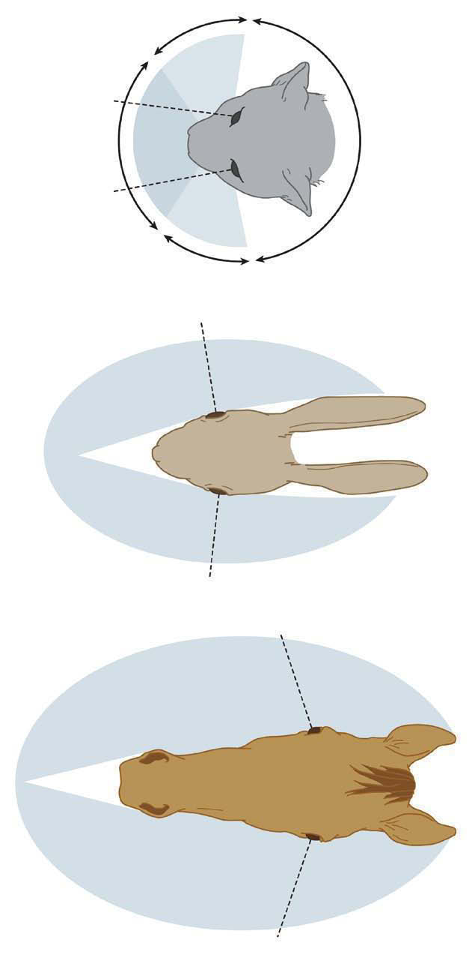

Slide 3
The eyeball
The eyeball of the domestic mammals is spherical with some anteroposterior compression in horses and cattle . The eyeball has three thin tunica , that surrounds the partly liquid , partly gelatinous centre . The three tunica are :-
1- An externals fibrous layer for protection the eyeball , it’s the only complete tunica Consist of two segments of two spheres that differ in sizes.
A- The Sclera- - المتصلبه . |The larger segment of the larger sphere , and appears superficially as the (white of the eye) as it is formed of collagen fibers with some elastic fibers . The ocular muscle are inserted to the external surface of the sclera .
B - Cornea – القرنية : The smaller segment of the smaller sphere . It forms the transparent anterior portion of the eye. It has no blood vessels except at its periphery .
At the caudo ventral part of the fibrous layer , the optic nerve pierces the sclera . The two segments are connected at the corneo scleral junction (limbus) .

Slide 4
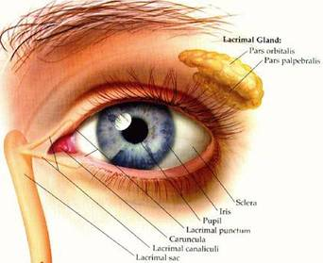

Slide 5
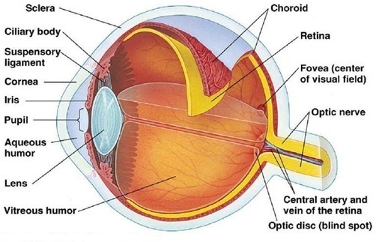
Cross section view of the eye

Slide 6
2- Middle vascular tunica that consist largely of blood vessels and smooth muscle and is concerned with the nutrition of the eyeball and regulation of the shape of the lens and size of the pupil .
It consist of :-
A- Choroid : Dark brown membrane attached to the sclera by connective tissue . It has light reflecting area .

Slide 7
B- Ciliary body : It is a black pigmented body that appears to surround the lens , its function is represented in changing the shape of the lens that give the eye the ability to focus on near or distance objects .
C- Iris (قزحية ) : composed of a flat ring of the tissue attached at its periphery to the sclera and the ciliary body ; the opening in the centre is the pupil through which light enters to the eye , that regulated by smooth muscle fibers .

Slide 8
3- An internal nervous tunica that consist largely of nervous tissue and directly concerned with the vision .
Focusing Light
The lens is a transparent structure located behind the iris and held in place by ligaments. The animal uses the lens to focus on nearby objects.
Posterior Segment or Fundus
Vitreous chamber--This is the large space between the lens and retina that contains the very thick vitreous.

Slide 9
3 - Retina--The retina is the most complex structure of the eye and is the most metabolically active tissue in the body. It converts light energy into chemical energy to generate the electrical signal that is conducted to the brain in order for the vision .
The retina contains a high number of very large ganglion cells that conduct the visual impulses quickly.

